Slide 1
ELECTRONIC COMMERCE FUNDAMANTALS
E-commerce is changing the shape of competition, the speed of action, and the stream­lining of interactions, products, and payments from customers to companies and from companies to suppliers.

Slide 2
Introduction to e-Commerce
For most companies today, electronic commerce encompasses the entire online process of
developing,
marketing,
selling,
delivering,
servicing, and
paying for
products and services transacted on internetworked, global marketplaces of customers, with the support of a worldwide network of business partners.

Slide 3
e-Commerce systems rely on the resources of the Internet and many other information technologies to support every step of this process.
Many companies, large and small, are engaged in some form of e-commerce activities.
Therefore, developing an e-commerce capability has become an important option that should be considered by most businesses today.
Read the Real World case on eBay Inc. on the next page.

Slide 4
The Scope of e-Commerce
The figure on the next slide illustrates the range of business processes involved in the marketing, buying, selling, and servicing of products and services in companies that engage in e-commerce
Companies involved in e-commerce as either buyers or sellers rely on Internet-based technologies, and e-commerce applications and services to accomplish
marketing, discovery, transaction processing, and product and customer service processes.
For example, electronic commerce can include
interactive marketing,
ordering,
payment, and
customer support processes
at e-commerce catalog and auction sites on the World Wide Web.

Slide 5
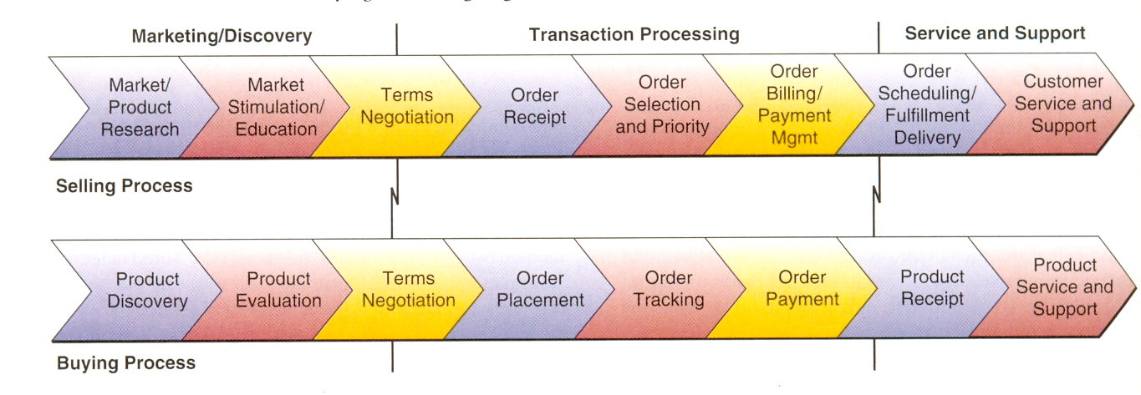
E-commerce involves accomplishing a range of business processes to support the electronic buying and selling of goods and services

Slide 6
But e-commerce also includes e-business processes such as
extranet access of inventory databases by customers and suppliers (transaction processing),
intranet access of customer relationship management systems by sales and customer service reps (service and support),
and customer collaboration in product development via e-mail exchanges and Internet news groups (marketing/discovery).

Slide 7
e-Commerce Technologies
What technologies are necessary for electronic commerce? The short answer is that most information technologies and Internet technologies are involved in electronic commerce systems.
A more specific answer is illustrated in the figure on the next slide, which is an example of the technology resources required by many e­commerce systems.
Web browser suits, HTML Web page editors, Interne t and intranet servers and network management software, TCP/IP Internet networking products, network security firewalls, etc.
The figure illustrates some of the hardware, software, data and network components used by Free Markets Inc. to provide B2B online auction e­commerce services.

Slide 8
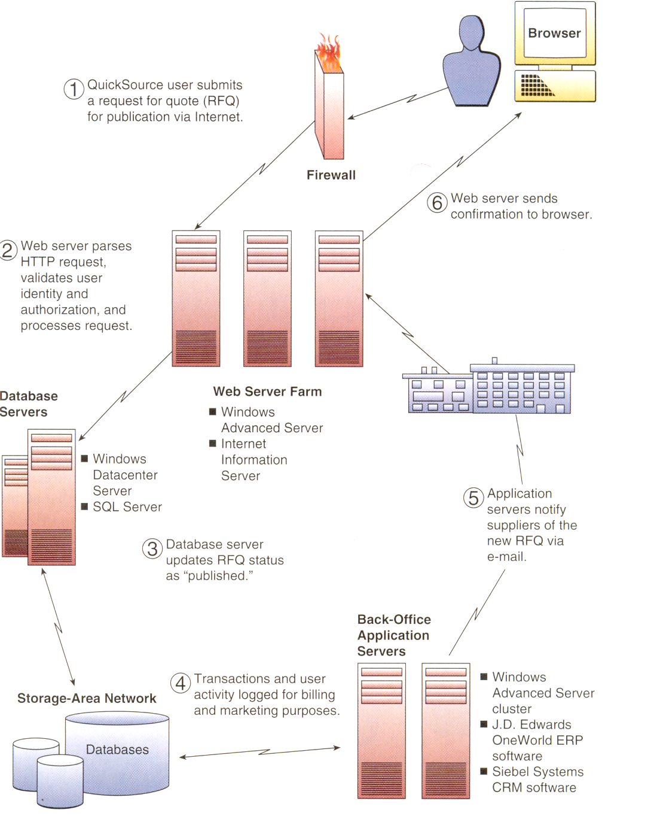

Slide 9
Categories of e-Commerce
Many companies today are participating in or sponsoring three basic categories of electronic commerce applications:
business-to-consumer,
business-to-business, and
consumer-to-consumer
e-commerce.
Note: We will not explicitly cover business­ -to-government (B2G) and e-government applications in this text. However, many e-commerce concepts apply to such applications.

Slide 10
Business-to-Consumer (B2C) e-Commerce.
In this form of electronic commerce, businesses must develop attractive electronic marketplaces to sell products and services to consumers.
For example, many companies offer e-commerce websites that provide
virtual storefronts and multimedia catalogs,
interactive order processing,
secure electronic payment systems, and
online customer support.

Slide 11
Business-to-Business (B2B) e-Commerce.
This category of electronic commerce involves both
electronic business marketplaces and
direct market links between businesses.
For example, many companies offer secure Internet or extranet e-commerce catalog websites for their business customers and suppliers.
Also very important are B2B e-commerce portals that provide
auction and
exchange marketplaces for businesses.
Others may rely on electronic data interchange (EDI) via the Internet or extranets for computer-to-computer exchange of e-commerce documents with their larger business customers and suppliers.

Slide 12
Consumer-to-Consumer (C2C) e-Commerce.
The huge success of online auctions like eBay, where consumers (as well as businesses) can buy and sell with each other in an auction process at an auction website, makes this e-commerce model an important e-commerce business strategy.
Thus, participating in or sponsoring consumer or business auctions is an important e-commerce alternative for
B2C,
C2B (consumer-to-business), or
B2B e-commerce.

Slide 13
Electronic personal advertising of products or services to buy or sell by consumers at electronic newspaper sites, consumer e-commerce portals, or personal websites is also an important form of C2C e-commerce.

Slide 14
Essential e-Commerce Processes
The essential e-commerce processes required for the successful operation and management of e-commerce activities are illustrated in the next figure.
This figure outlines the nine key components of an e-commerce process architecture that is the foundation of the e-commerce initiatives of many companies today.
We will concentrate on the role these processes play in e-commerce systems
Let's take a brief look at each essential process category.

Slide 15
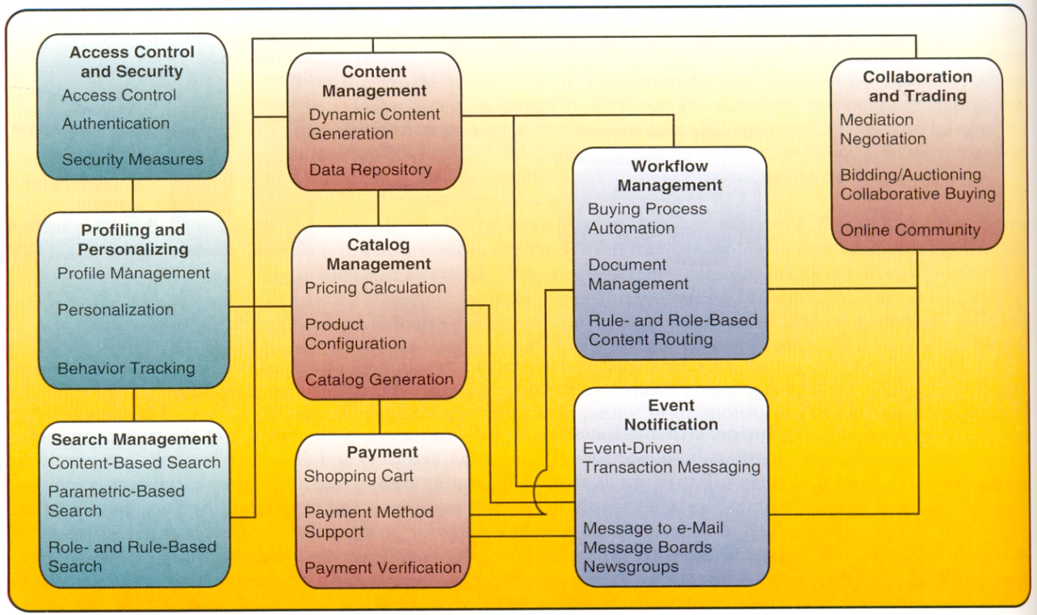
Essential e-Commerce Processes

Slide 16
Access Control and Security
E-commerce processes must establish mutual trust and secure access between the parties in an e-commerce transaction by
authenticating users,
authorizing access, and
enforcing security features.
For example, these processes establish that a customer and e-commerce site are who they say they are through user names and passwords, encryption keys, or digital certificates and signatures.
The e-commerce site must then authorize access to only those parts of the site that an individual user needs to accomplish his or her particular transactions.
Thus, you usually will be given access to all resources of an e-commerce site except for other people's accounts, restricted company data, and webmaster administration areas.

Slide 17
Companies engaged in B2B e-commerce may rely on
secure industry exchanges for procuring goods and services, or
Web trading portals that allow only registered customers access to trading information and applications.
Other security processes protect the resources of e-commerce sites from threats such as
hacker attacks,
theft of passwords or credit card numbers, and
system failures.

Slide 18
Profiling and Personalizing
Once you have gained access to an e-commerce site, profiling processes can occur that gather data on you and your website behavior and choices, and build electronic profiles of your characteristics and preferences.
User profiles are developed using profiling tools such as
user registration,
cookie files,
website behavior tracking software, and
user feedback.

Slide 19
These profiles are then used to
recognize you as an individual user
and provide you with a
personalized view of the contents of the site, as well as
product recommendations and
personalized Web advertising as part of a one-to-one marketing strategy.
Profiling processes are also used
to help authenticate your identity for account management and payment purposes, and
to gather data for
customer relationship management,
marketing planning, and
website management.
Read article on Be Free and Supergo Bike Shops: Personalizing e-commerce

Slide 20
Search Management
Efficient and effective search processes provide a top e-commerce website capability that helps customers find the specific product or service they want to evaluate or buy.
E-commerce software packages can include
a website search engine component, or
a company may acquire a customized e-commerce search engine from search technology companies like Google and Requisite Technology.
Search engines may use a combination of search techniques, including searches
based on content (a product description, for example),
or by parameters (above, below, or between a range of values for multiple properties of a product, for example).

Slide 21
Content and Catalog Management
Content management software helps e-commerce companies develop, generate, deliver, update, and archive text data and multimedia information at e-commerce websites.
E-commerce content frequently takes the form of multimedia catalogs of product information. So generating and managing catalog content is a major subset of content management.
Content and catalog management software work with the profiling tools we mentioned earlier to personalize the content of Web pages seen by individual users.

Slide 22
For example, Travelocity.com uses OnDisplay content manager software to push personalized promotional information about other travel opportunities to users while they are involved in an online travel-related transaction.
Finally, content and catalog management may be expanded to include product configuration processes that support Web-based customer self-service and the mass customization of a company's products.

Slide 23
Configuration software helps online customers select the optimum feasible set of product features that can be included in a finished product.
For example, both Dell Computer and Cisco Systems use configuration software to sell build-to-order computers and network processors to their online customers.

Slide 24
Workflow Management
Many of the business processes in e-commerce applications can be managed and partially automated with the help of workflow management software.
Workflow management in both e-business and e-commerce depends on a workflow software engine containing software models of the business processes to be accomplished.

Slide 25
The workflow models express the predefined sets of business rules, roles of stakeholders, authorization requirements, routing alternatives, databases used, and sequence of tasks required for each e-commerce process.
Thus, workflow systems ensure that the proper transactions, decisions, and work activities are performed, and the correct data and documents are routed to the right employees, customers, suppliers, and other business stakeholders.

Slide 26
For example, the figure below illustrates the e-commerce procurement processes of the MS Market system of Microsoft Corporation.
Microsoft employees use their global intranet and the catalog/content management and workflow management software engines built into MS Market to electronically purchase more than $3 billion annually of business supplies and materials from approved suppliers connected to the MS Market system by their corporate extranets.
Read Case on Microsoft corporation: e-Commerce Purchasing Processes

Slide 27
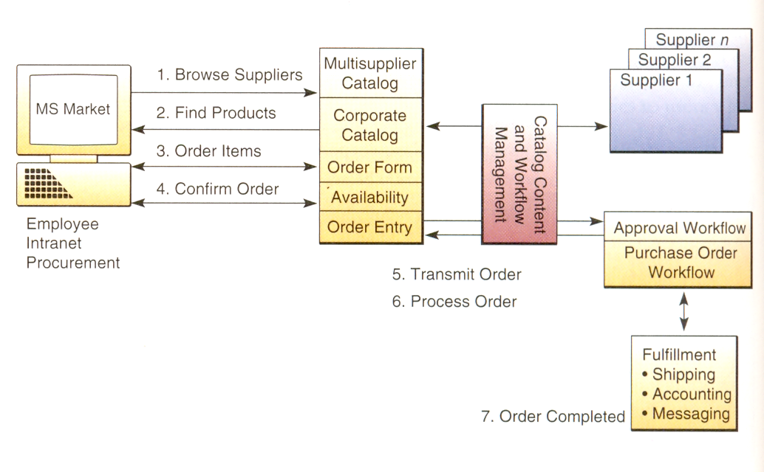
The role of catalog/content management and workflow management in a Web­based procurement process: the MS Market system used by Microsoft Corporation.

Slide 28
Event Notification
Most e-commerce applications are event-driven systems that respond to a multitude of events - from a new customer's first website access, to payment and delivery processes, and to innumerable customer relationship and supply chain management activities.
It notifies all stakeholders of all events that might affect their status in a transaction.
Event notification software works with the workflow management software to monitor all e­commerce processes and record all relevant events, including unexpected changes or problem situations.

Slide 29
Then it works with user-profiling software to automatically notify all involved stakeholders of important transaction events using appropriate user-preferred methods of electronic messaging, such as e-mail, newsgroup, pager, and fax communications.
This includes notifying a company's management so they can monitor their employees' responsiveness to e-commerce events and customer and supplier feedback.

Slide 30
For example, when you purchase a product at a retail e-commerce website like Amazon.com, you automatically receive an e-mail record of your order. Then you may receive e-mail notifications of any change in product availability or shipment status, and finally, an e-mail message notifying you that your order has been shipped and is complete.

Slide 31
Collaboration and Trading
This major category of e-commerce processes are those that support the vital collaboration arrangements and trading services needed by customers, suppliers, and other stakeholders to accomplish e-commerce transactions.
Earlier, we discussed how a customer-focused e-business uses tools such as e-mail, chat systems, and discussion groups to nurture online communities of interest among employees and customers to enhance customer service and build customer loyalty in e­commerce.
The essential collaboration among business trading partners in e-commerce may also be provided by Internet-based trading services. For example, B2B e-commerce Web portals provided by companies like Ariba and Commerce One support
matchmaking,
negotiation, and
mediation processes among business buyers and sellers.

Slide 32
In addition, B2B e-commerce is heavily dependent on Internet-based trading platforms and portals that provide online exchange and auctions for e-business enterprises.

Slide 33
Electronic Payment Processes
Payment for the products and services purchased is an obvious and vital set of processes in electronic commerce transactions.
But payment processes are not simple, because of the near-anonymous electronic nature of transactions taking place between the networked computer systems of buyers and sellers, and the many security issues involved.
Electronic commerce payment processes are also complex because of the wide variety of debit and credit alternatives and financial institutions and intermediaries that may be part of the process.
Therefore, a variety of electronic payment systems have evolved over time.

Slide 34
Web Payment Processes
Most e-commerce systems on the Web involving businesses and consumers (B2C) depend on credit card payment processes.
But many B2B e-commerce systems rely on more complex payment processes based on the use of purchase orders, as was illustrated in the previous figure.
However, both types of e-commerce typically use an electronic shopping Cart process, which enables customers to select products from website catalog displays and put them temporarily in a virtual shopping basket for later checkout and processing.
The next Figure illustrates and summarizes a B2C electronic payment system with several payment alternatives.

Slide 35
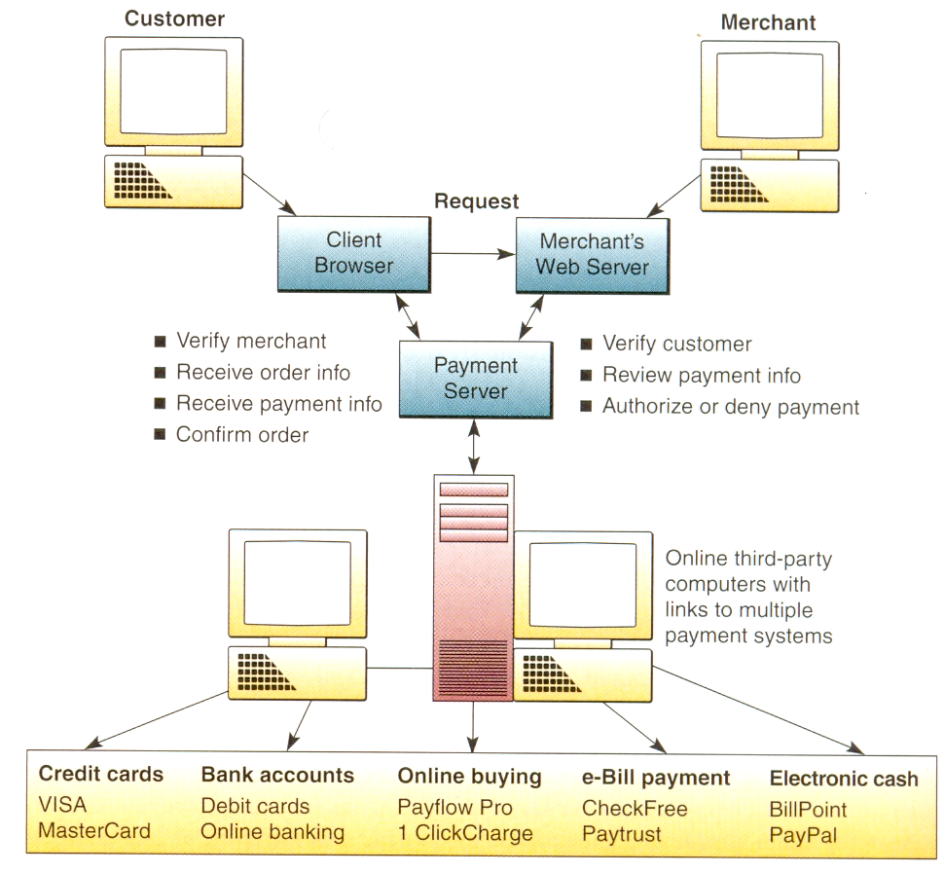
An example of a secure electronic payment system with many payment alternatives.

Slide 36
Electronic Funds Transfer
Electronic funds transfer (EFT) systems are a major form of electronic payment systems in banking and retailing industries.
EFT systems use a variety of information technologies to capture and process money and credit transfers between banks and businesses and their customers.
For example, banking networks support teller terminals at all bank offices and automated teller machines (ATMs) at locations throughout the world.
Banks, credit card companies, and other businesses may support pay-by-phone services.
In addition, most point-of-sale terminals in retail stores are net­worked to bank EFT systems. This makes it possible for you to use a credit card or debit card to instantly pay for gas, groceries, or other purchases at participating retail outlets.

Slide 37
Secure Electronic Payments
When you make an online purchase on the Internet, your credit card information is vulnerable to interception by network sniffers, software that easily recognizes credit card number formats.
Several basic security measures are being used to solve this security problem:
encrypt (code and scramble) the data passing between the customer and merchant,
encrypt the data passing between the customer and the company au­thorizing the credit card transaction, or
take sensitive information offline.

Slide 38
For example, many companies use the Secure Socket Layer (SSL) security method developed by Netscape Communications that automatically encrypts data passing between your Web browser and a merchant's server.
However, sensitive information is still vulnerable to misuse once it's decrypted (decoded and unscrambled) and stored on a merchant's server.

Slide 39
So a digital wallet payment system was developed.
In this method, you add security software add-on modules to your Web browser. That enables your browser to encrypt your credit card data in such a way that only the bank that authorizes credit card transactions for the merchant gets to see it. All the merchant is told is whether your credit card transaction is approved or not.

Slide 40
The Secure Electronic Transaction, or SET, standard for electronic payment security extends this digital wallet approach. In this method, software encrypts a digital envelope of digital certificates specifying the payment details for each transaction.
SET has been agreed to by VISA, MasterCard, IBM, Microsoft, Netscape, and most other industry players.
Therefore, a system like SET may become the standard for secure electronic payments on the Internet.
However, SET has been stalled by the reluctance of companies to incur its increased hardware, software, and cost requirements [].

